Slide 1

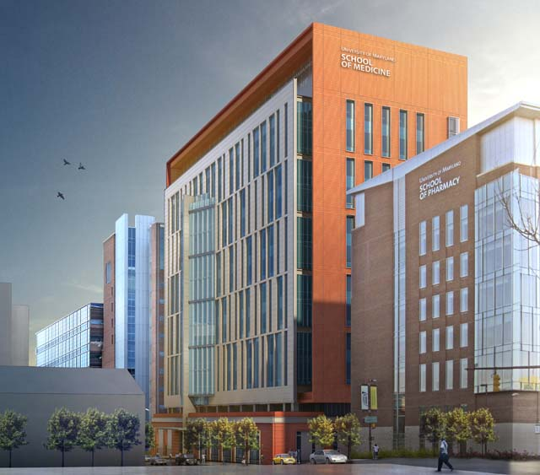
UNIVERSITY OF MARYLAND – BALTIMORE
HEALTH SCIENCES FACILITY III
SCHEMATIC DESIGN
KENNETH M. MOORE
LIGHTING / ELECTRICAL
THESIS ADVISOR │ SHAWN GOOD

Slide 2






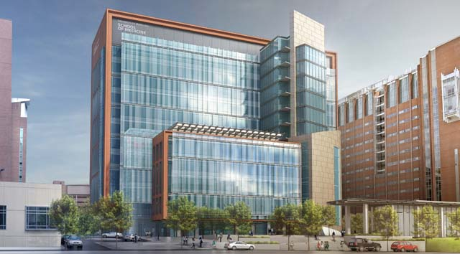
PROJECT
HEALTH SCIENCE FACILITY III
HOUSES RESEARCH GROUPS FOR SCHOOLS OF MEDICINE, PHARMACY, AND DENTISTRY
SHARE NANOMEDICINE CENTER
DRY LAB, WET LAB, ATRIUM CONNECTION
ARCHITECT: HELLMUTH, OBATA, KASSABAUM (HOK)
CONSTRUCTION MANAGER: BARTON MALOW COMPANY
BACKGROUND

Slide 3

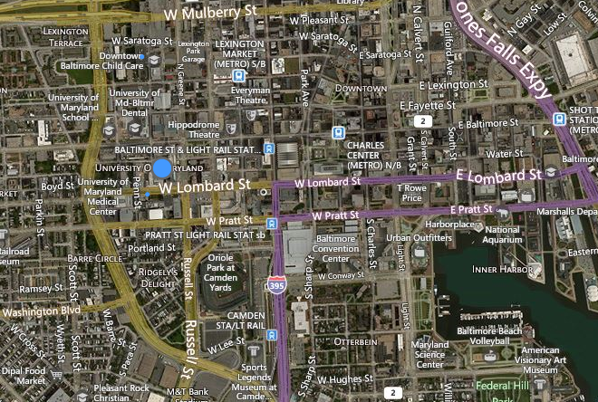
PROJECT
666 W. BALTIMORE ST.
CITY OF BALTIMORE
SEVERAL BLOCKS FROM INNER HARBOR
CENTRAL LOCATION IN UNIVERSITY CAMPUS
N
LOCATION

Slide 4
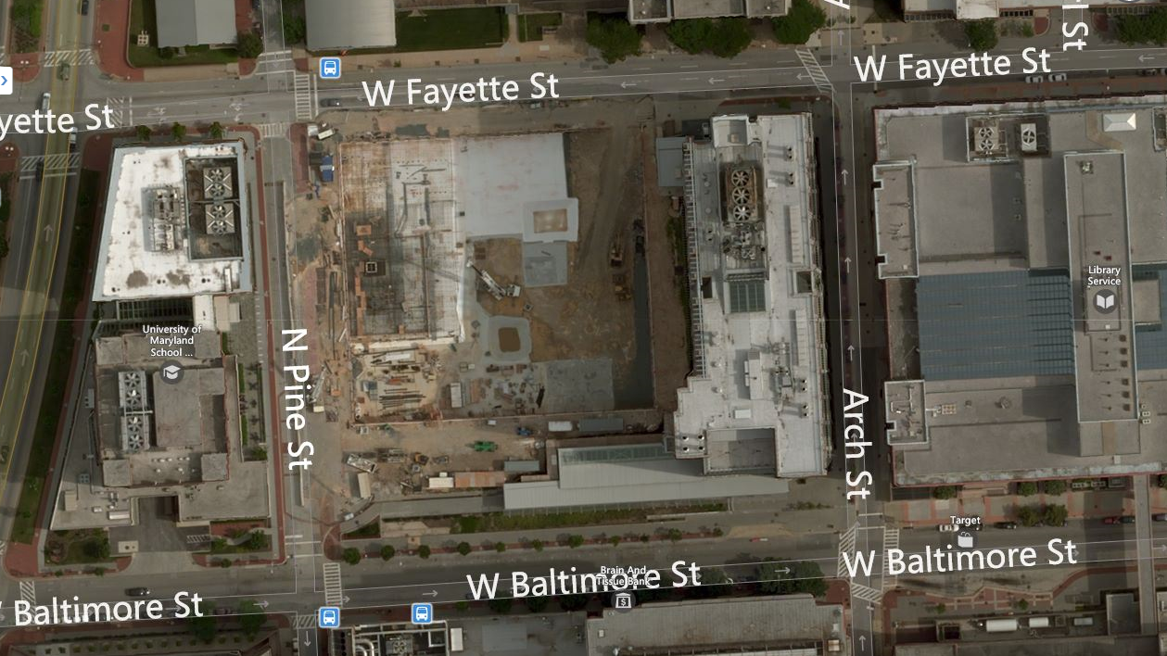

PROJECT
666 W. BALTIMORE ST.
N
LOCATION

Slide 5
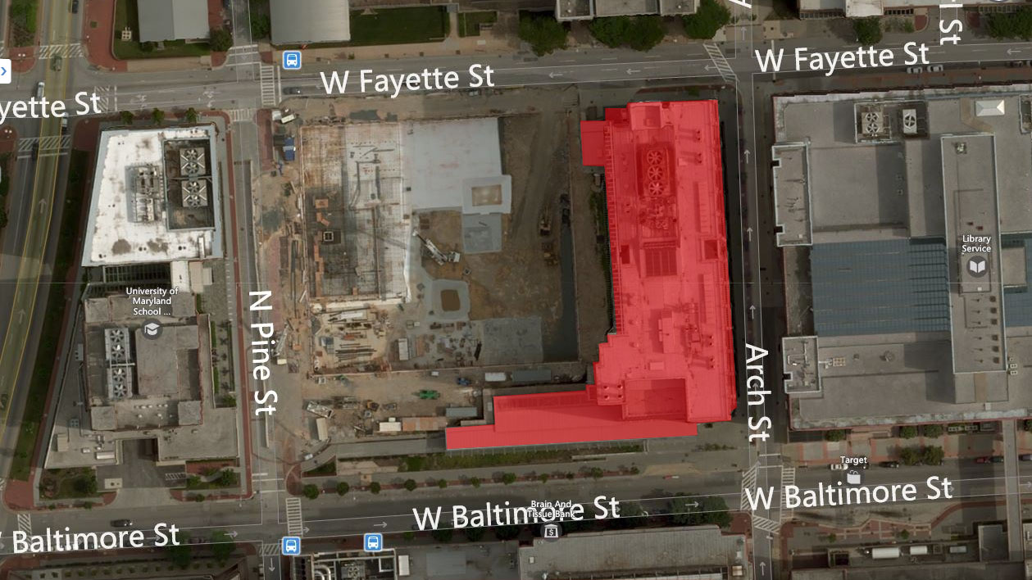
PROJECT
666 W. BALTIMORE ST.
SCHOOL OF DENTISTRY
N
LOCATION

Slide 6
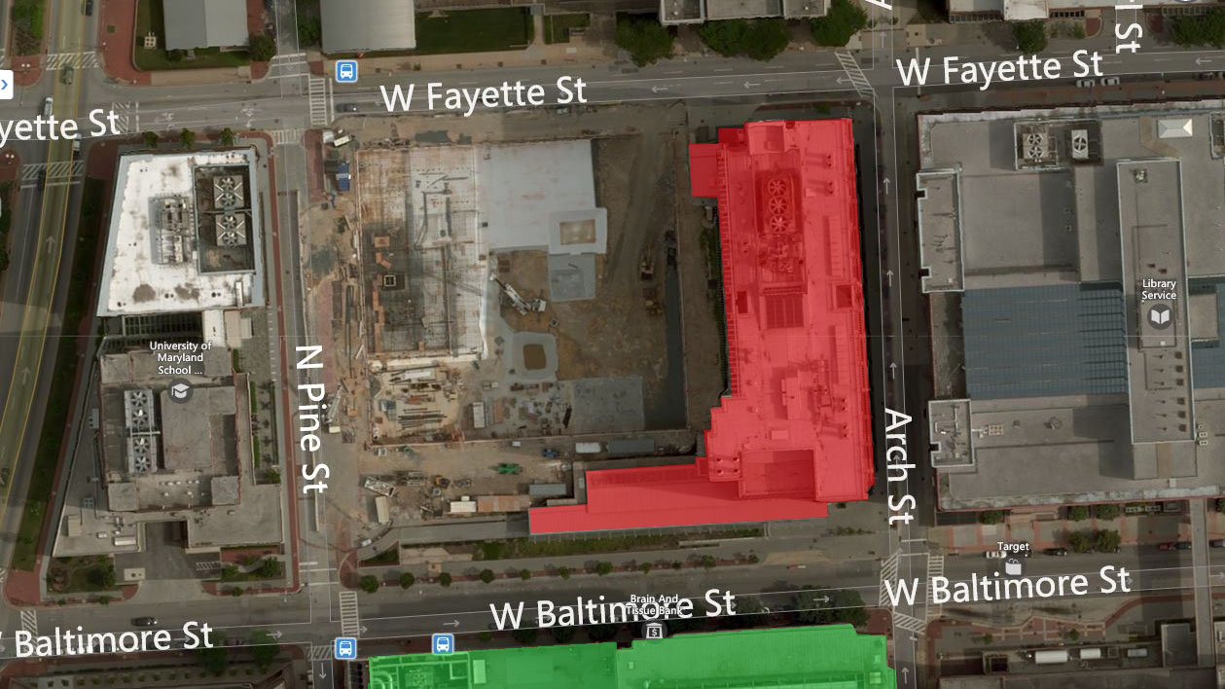
PROJECT
666 W. BALTIMORE ST.
SCHOOL OF DENTISTRY
SCHOOL OF MEDICINE
N
LOCATION

Slide 7
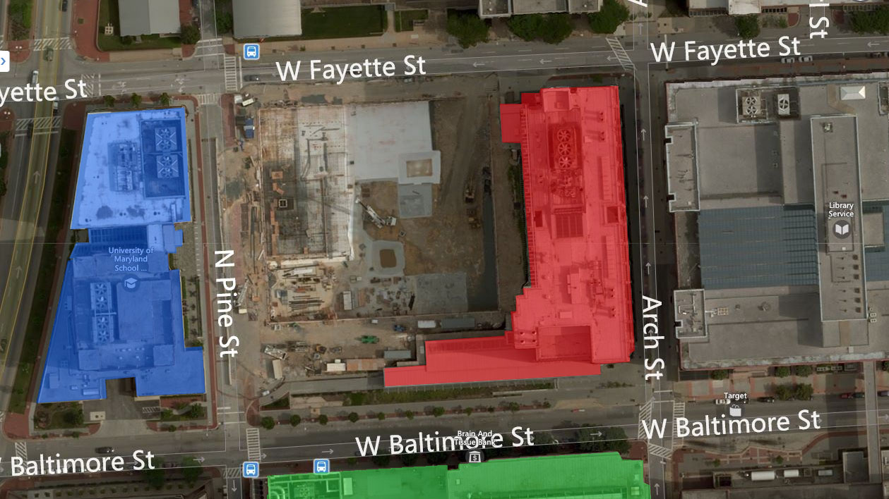
PROJECT
666 W. BALTIMORE ST.
SCHOOL OF DENTISTRY
SCHOOL OF MEDICINE
SCHOOL OF PHARMACY
N
LOCATION

Slide 9
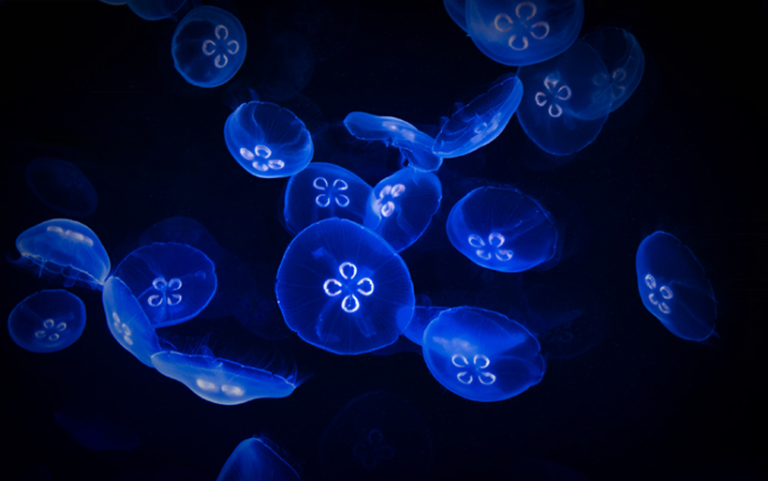

Slide 10

PROJECT
BIOLUMINESCENCE
THEME

Slide 11
PROJECT
BIOLUMINESCENCE
PRODUCTION AND EMISSION OF LIGHT BY A LIVING ORGANISM
THEME

Slide 12
PROJECT
BIOLUMINESCENCE
PRODUCTION AND EMISSION OF LIGHT BY A LIVING ORGANISM
GREEK: BIOS MEANING “LIVING”
THEME

Slide 13
PROJECT
BIOLUMINESCENCE
PRODUCTION AND EMISSION OF LIGHT BY A LIVING ORGANISM
GREEK: BIOS MEANING “LIVING”
LATIN: LUMEN MEANING “LIGHT”
THEME

Slide 14
PROJECT
BIOLUMINESCENCE
SIMPLE
UNSEEN
TEXTURE
THEME

Slide 15
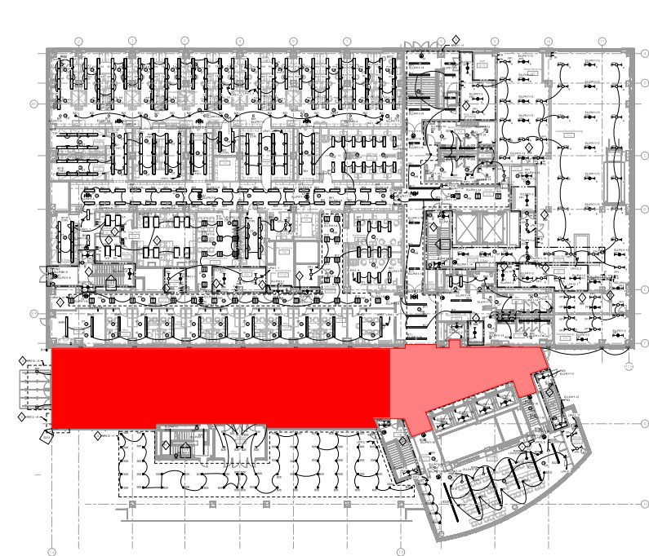

MAIN
ATRIUM

Slide 16
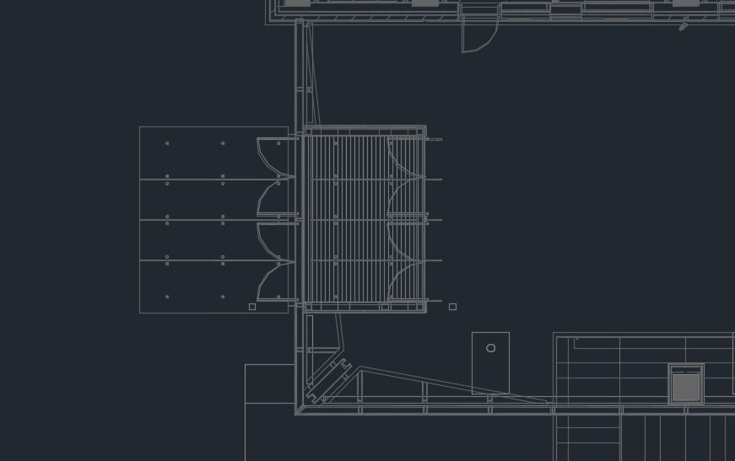
MAIN
DESIGN CRITERIA
PROVIDE TARGET ILLUMINANCE RECOMMENDED FOR CANOPIED ENTRIES, VESTIBULES, AND RECEPTION LOBBIES
CONSIDER HIGH PEDESTRIAN VOLUME AND TRAFFIC
PSYCHOLOGICAL IMPRESSION OF SPACIOUSNESS
ATRIUM CANOPIED ENTRY + VESTIBULE

Slide 17
MAIN
DESIGN CRITERIA
CANOPIED ENTRIES: LIGHTING ZONE 3
(DAYTIME HOURS)
HORIZANTAL ILLUMINANCE: 30 LUX
VERTICAL ILLUMINANCE: 15 LUX
VESTIBULE: HIGH ACTIVITY
(DAYTIME HOURS)
HORIZANTAL ILLUMINANCE: 150 LUX
VERTICAL ILLUMINANCE: 75 LUX
ATRIUM > 40 FT IN HEIGHT
0.40 + 0.20/FT TOTAL HEIGHT (W/FT²)
ATRIUM CANOPIED ENTRY + VESTIBULE

Slide 18
MAIN
DESIGN CRITERIA
CANOPIED ENTRIES: LIGHTING ZONE 3
(NIGHTTIME HOURS)
HORIZANTAL ILLUMINANCE: 20 LUX
VERTICAL ILLUMINANCE: 10 LUX
VESTIBULE: HIGH ACTIVITY
(NIGHTTIME HOURS)
HORIZANTAL ILLUMINANCE: 100 LUX
VERTICAL ILLUMINANCE: 50 LUX
LIGHTING POWER ALLOWANCES
GENERAL LOBBY SPACE: 0.9 W/FT²
ATRIUM CANOPIED ENTRY + VESTIBULE

Slide 19
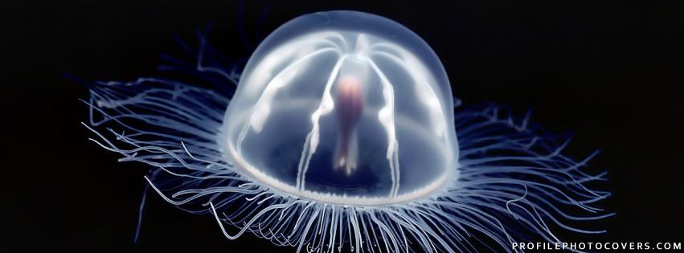

Slide 20
MAIN
DESIGN SOLUTION
ATRIUM CANOPIED ENTRY + VESTIBULE

Slide 21
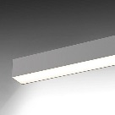
MAIN
DESIGN SOLUTION
SURFACE MOUNTED LINEAR DOWNLIGHT
ATRIUM CANOPIED ENTRY + VESTIBULE

Slide 22
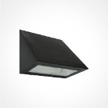
MAIN
DESIGN SOLUTION
SURFACE MOUNTED LINEAR DOWNLIGHT
SURFACE MOUNTED DOWNLIGHT
ATRIUM CANOPIED ENTRY + VESTIBULE

Slide 23
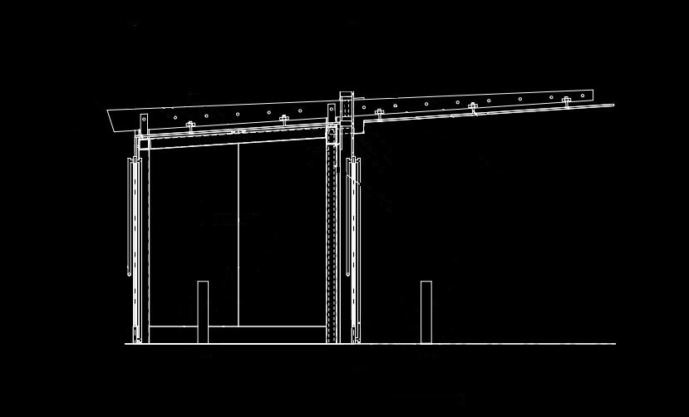
MAIN
DESIGN SOLUTION
EXTERIOR CANOPY
ATRIUM CANOPIED ENTRY + VESTIBULE

Slide 24
MAIN
DESIGN SOLUTION
SURFACE MOUNTED LINEAR DOWNLIGHT
ATRIUM CANOPIED ENTRY + VESTIBULE

Slide 25
MAIN
DESIGN SOLUTION
SURFACE MOUNTED LINEAR DOWNLIGHT
SURFACE MOUNTED DOWNLIGHT
ATRIUM CANOPIED ENTRY + VESTIBULE

Slide 26
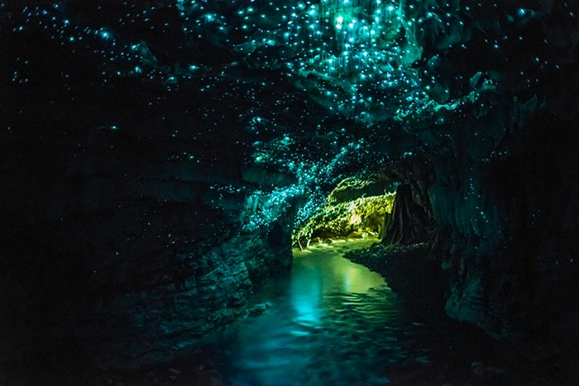

Slide 27
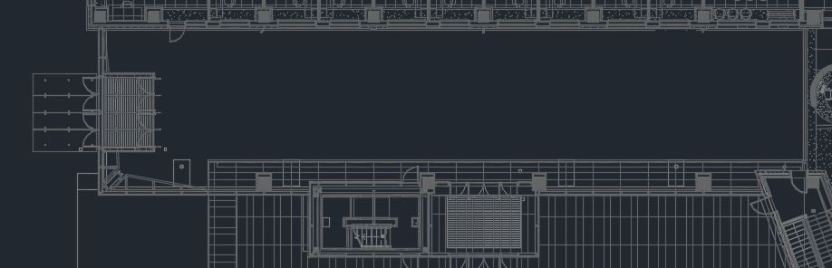
MAIN
DESIGN SOLUTION
ATRIUM CIRCULATION

Slide 28
MAIN
DESIGN SOLUTION
ATRIUM CIRCULATION

Slide 29

MAIN
DESIGN SOLUTION
ATRIUM CIRCULATION

Slide 30
MAIN
DESIGN SOLUTION
ATRIUM CIRCULATION

Slide 31
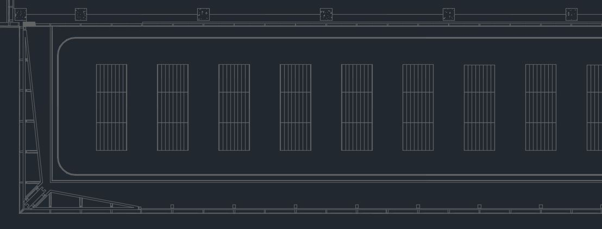
MAIN
DESIGN SOLUTION
ATRIUM CEILING

Slide 32
MAIN
DESIGN SOLUTION
ATRIUM CEILING

Slide 33
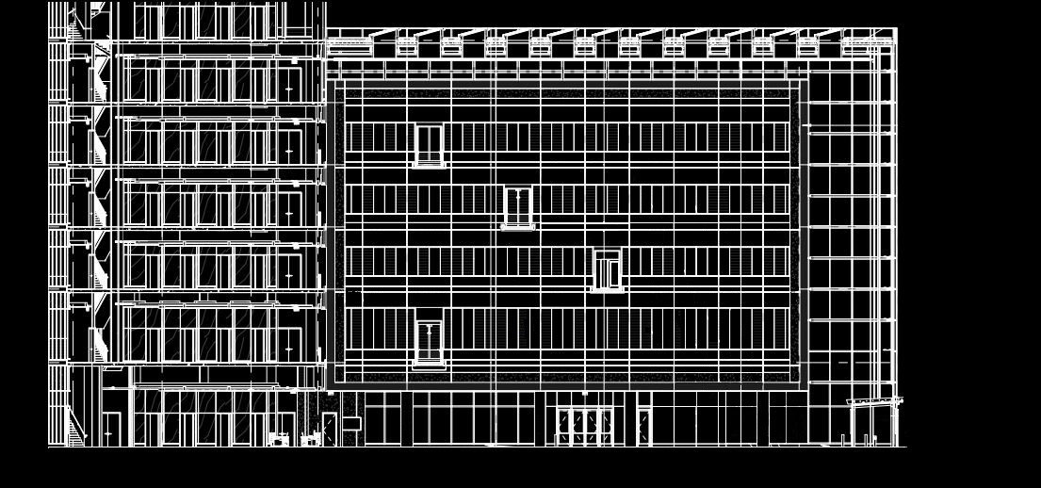
MAIN
DESIGN SOLUTION
ATRIUM BRIDGES

Slide 34
MAIN
DESIGN SOLUTION
BRIDGES SPAN ATRIUM
ATRIUM BRIDGES

Slide 35
MAIN
DESIGN SOLUTION
BRIDGES SPAN ATRIUM
CONNECTION BETWEEN DRY AND WET LABS
ATRIUM BRIDGES

Slide 36
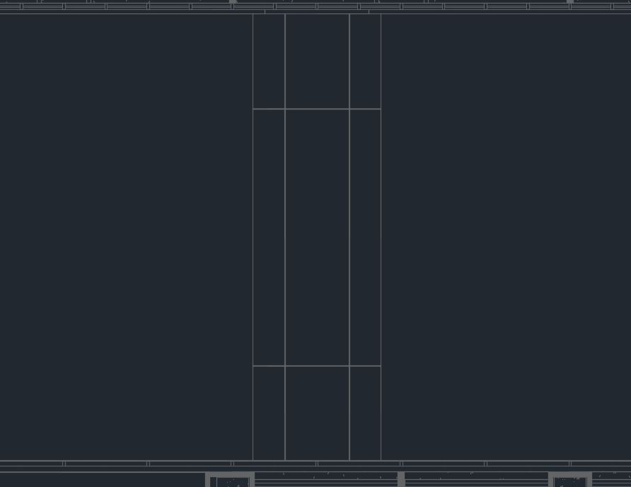
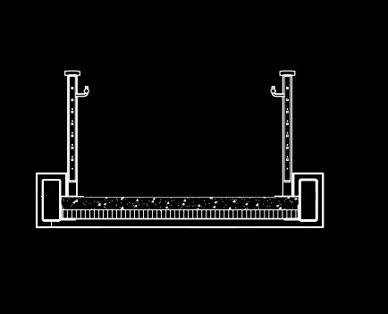
MAIN
DESIGN SOLUTION
ATRIUM BRIDGES

Slide 37
MAIN
DESIGN SOLUTION
ATRIUM BRIDGES

Slide 38
MAIN
DESIGN SOLUTION
ATRIUM BRIDGES

Slide 39
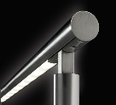
MAIN
DESIGN SOLUTION
HANDRAIL LIGHTING
ATRIUM BRIDGES

Slide 40
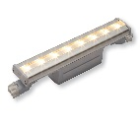
MAIN
DESIGN SOLUTION
LINEAR COVE
HANDRAIL LIGHTING
ATRIUM BRIDGES

Slide 41
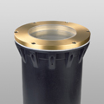
MAIN
DESIGN SOLUTION
LINEAR COVE
HANDRAIL LIGHTING
IN GRADE COLUMN LIGHTING
ATRIUM BRIDGES

Slide 42
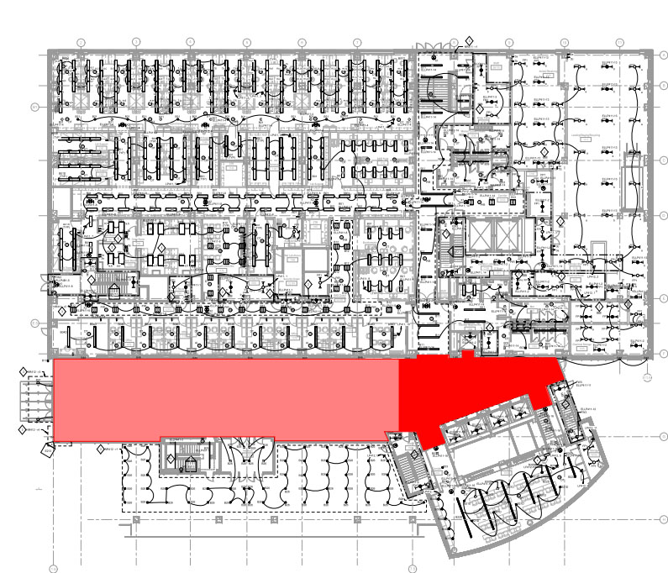

ELEVATOR
LOBBY

Slide 43

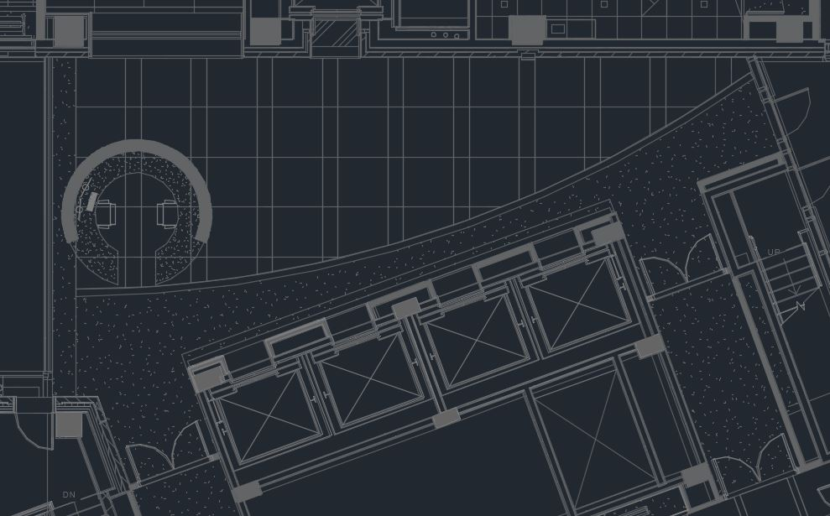
ELEVATOR
DESIGN CRITERIA
PROVIDE TARGET ILLUMINANCE RECOMMENDED FOR ELEVATOR LOBBIES
CONSIDER HIGH PEDESTRIAN VOLUME AND TRAFFIC
LIGHTING SHOULD ASSIST WITH ADAPTATION TO ATRIUM
LOBBY CIRCULATION

Slide 44
ELEVATOR
DESIGN CRITERIA
CIRCULATION: ELEVATOR LOBBIES
(DAYTIME HOURS)
HORIZANTAL ILLUMINANCE: 100 LUX
VERTICAL ILLUMINANCE: 30 LUX
(NIGHTTIME HOURS)
HORIZANTAL ILLUMINANCE: 50 LUX
VERTICAL ILLUMINANCE: 20 LUX
RECEPTION LOBBIES: DESKTOP
HORIZANTAL ILLUMINANCE: 150 LUX
VERTICAL ILLUMINANCE: 50 LUX
LIGHTING POWER ALLOWANCES
CONFERENCE/MEETING: 0.64 W/FT²
LOBBY CIRCULATION

Slide 46
ELEVATOR
DESIGN SOLUTION
LOBBY CIRCULATION

Slide 47
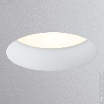
ELEVATOR
DESIGN SOLUTION
RECESSED DOWNLIGHTS
LOBBY CIRCULATION

Slide 48
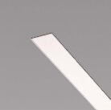
ELEVATOR
DESIGN SOLUTION
RECESSED DOWNLIGHTS
RECESSED LINEAR DOWNLIGHT
LOBBY CIRCULATION

Slide 49
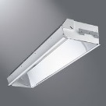
ELEVATOR
DESIGN SOLUTION
RECESSED DOWNLIGHTS
RECESSED LINEAR DOWNLIGHT
RECESSED LINEAR COVE
LOBBY CIRCULATION

Slide 50
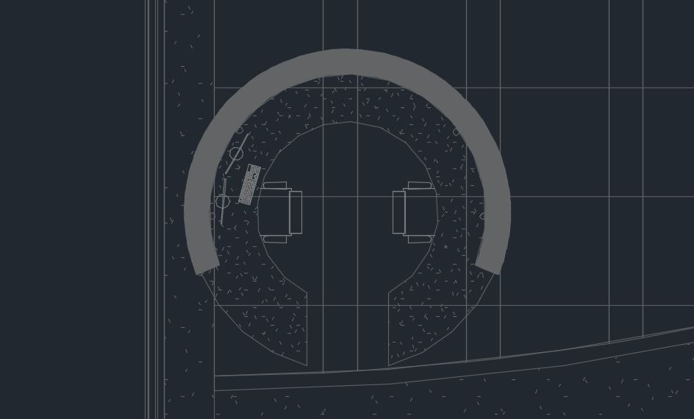
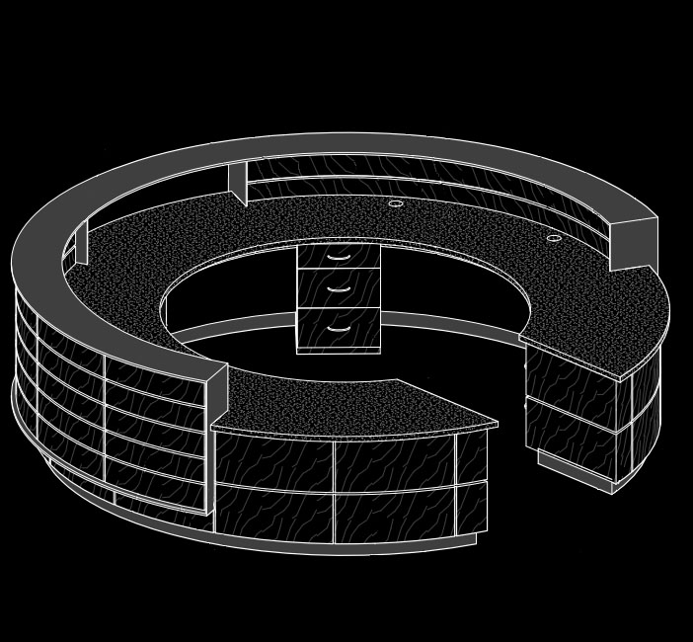
ELEVATOR
DESIGN SOLUTION
LOBBY INFORMATION DESK

Slide 51
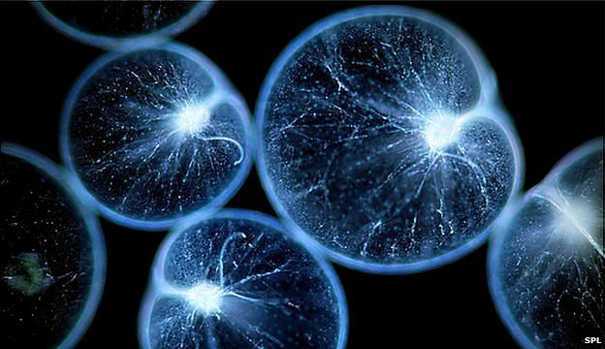

Slide 52
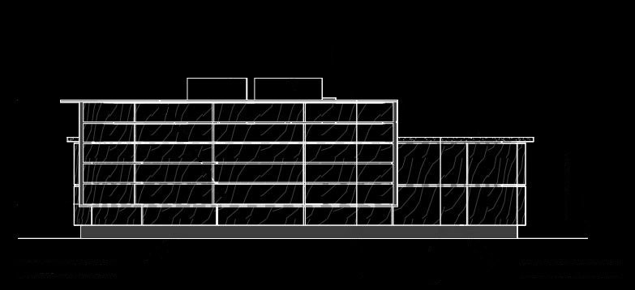
ELEVATOR
DESIGN SOLUTION
LOBBY INFORMATION DESK

Slide 53
ELEVATOR
DESIGN SOLUTION
LOBBY INFORMATION DESK

Slide 54
ELEVATOR
DESIGN SOLUTION
LOBBY INFORMATION DESK

Slide 55
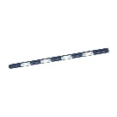
ELEVATOR
DESIGN SOLUTION
UNDER CABINET LIGHTING
LOBBY INFORMATION DESK

Slide 56
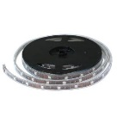
ELEVATOR
DESIGN SOLUTION
UNDER CABINET LIGHTING
SURFACE TAPE LIGHT
LOBBY INFORMATION DESK

Slide 57
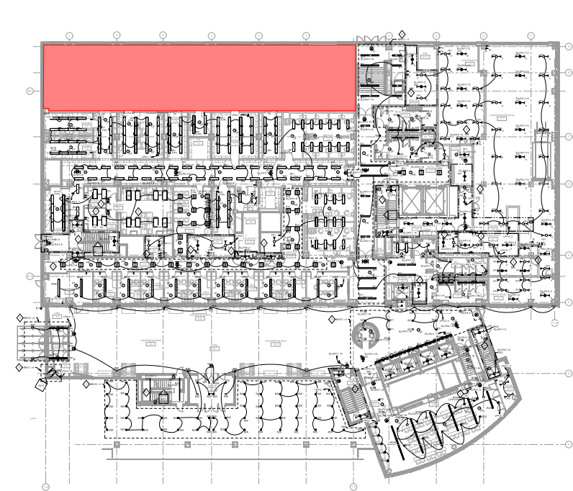

NANOMEDICINE
WORKSTATION

Slide 58
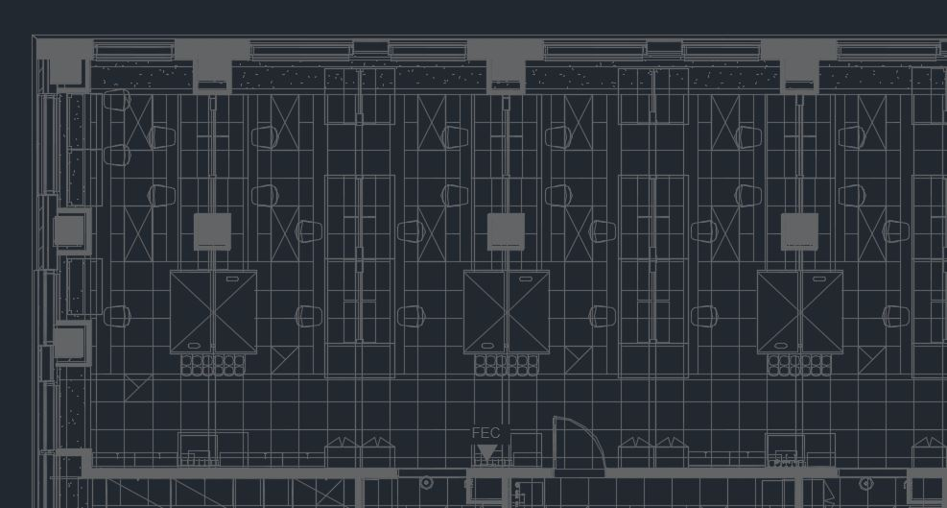
NANOMEDICINE
DESIGN CRITERIA
PROVIDE TARGET ILLUMINANCE RECOMMENDED FOR SCIENCE LABS
WORKSTATION

Slide 59
NANOMEDICINE
DESIGN CRITERIA
PROVIDE TARGET ILLUMINANCE RECOMMENDED FOR SCIENCE LABS
WORKSTATION BENCHES ARE PRIORITY
WORKSTATION

Slide 60
NANOMEDICINE
DESIGN SOLUTION
PROVIDE TARGET ILLUMINANCE RECOMMENDED FOR SCIENCE LABS
WORKSTATION BENCHES ARE PRIORITY
AVOID SHELVING, CASEWORK, AND FUME HOODS
WORKSTATION

Slide 61
NANOMEDICINE
DESIGN SOLUTION
SCIENCE LAB: BENCH
HORIZANTAL ILLUMINANCE: 500 LUX
VERTICAL ILLUMINANCE: 300 LUX
SCIENCE LAB: PRESENTATION AREA
HORIZANTAL ILLUMINANCE: 1000 LUX
VERTICAL ILLUMINANCE: 500 LUX
LIGHTING POWER ALLOWANCES
WORKSHOP: 1.59 W/FT²
WORKSTATION

Slide 62
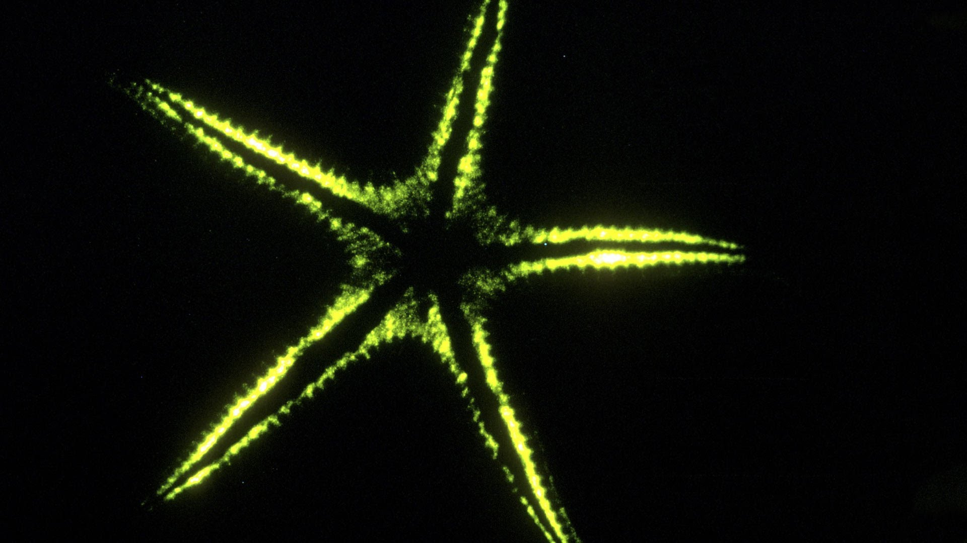

Slide 63
NANOMEDICINE
DESIGN SOLUTION
PROVIDE TARGET ILLUMINANCE RECOMMENDED FOR SCIENCE LABS
WORKSTATION BENCHES ARE PRIORITY
AVOID SHELVING, CASEWORK, AND FUME HOODS
WORKSTATION

Slide 64
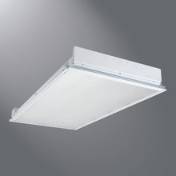
NANOMEDICINE
DESIGN SOLUTION
RECESSED LINEAR TROFFER
WORKSTATION

Slide 65
NANOMEDICINE
DESIGN SOLUTION
RECESSED LINEAR TROFFER
RECESSED DOWNLIGHTS
WORKSTATION

Slide 66
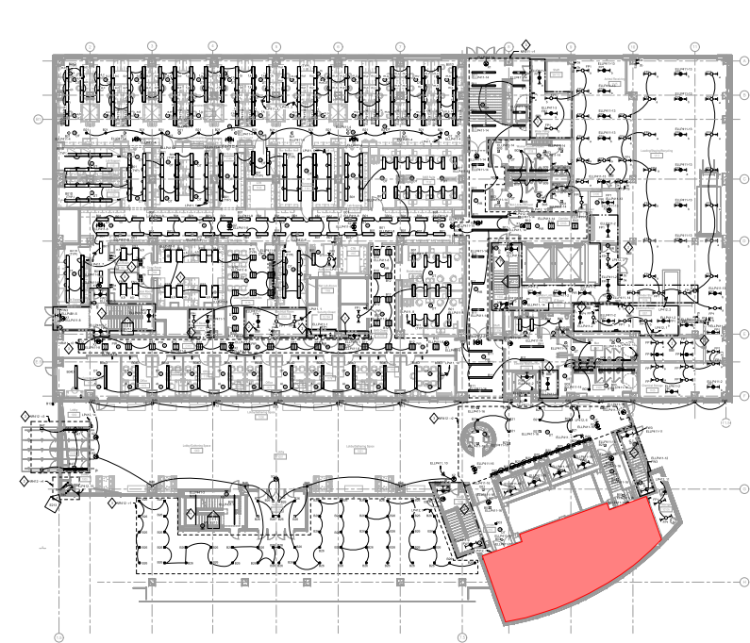

MEETING
ROOM

Slide 67
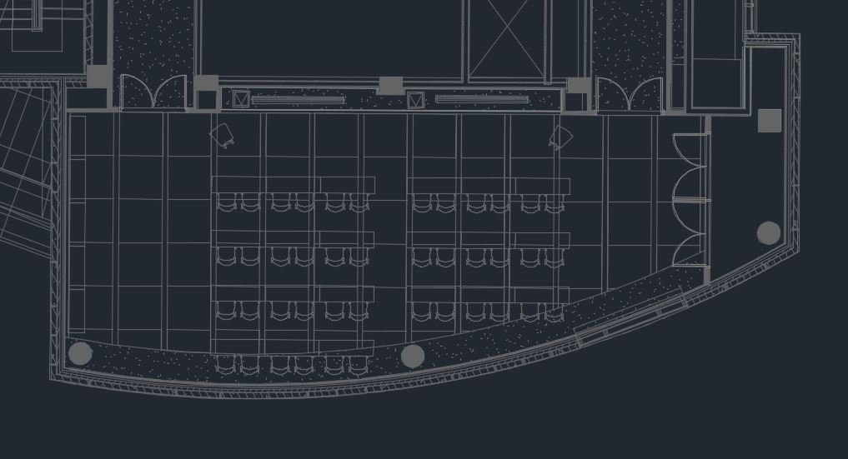
MEETING
DESIGN CRITERIA
MAINTAIN TARGET ILLUMINANCE RECOMMENDED FOR CONFERENCING
CONSIDER AUDIO - VISUAL EQUIPMENT
APPLY 3 SCHEMATIC CONCEPTS
ROOM

Slide 68
MEETING
DESIGN CRITERIA
CONFERENCE: MEETING
HORIZANTAL ILLUMINANCE: 300 LUX
VERTICAL ILLUMINANCE: 100 LUX
CONFERENCE: AV PRESENTATION
HORIZANTAL ILLUMINANCE: 30 LUX
VERTICAL ILLUMINANCE: 30 LUX
LIGHTING POWER ALLOWANCES
CONFERENCE/MEETING: 1.23 W/FT²
ROOM

Slide 69
MEETING
DESIGN SOLUTION
ROOM

Slide 70
MEETING
DESIGN SOLUTION
RECESSED LINEAR COVE
ROOM

Slide 71
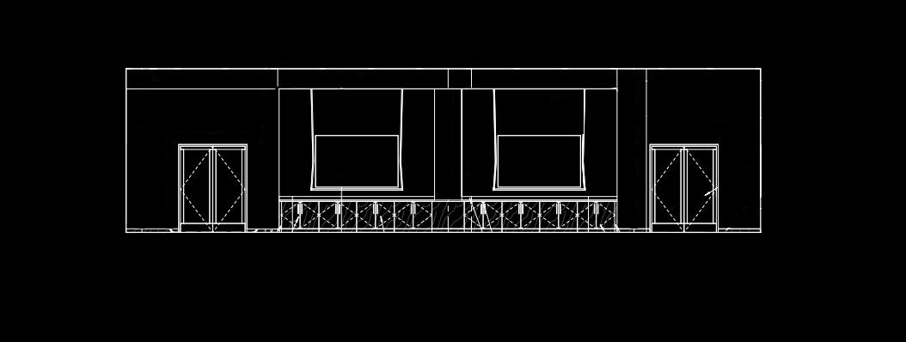
MEETING
DESIGN SOLUTION
NORTH WALL SECTION VIEW
ROOM

Slide 72
MEETING
DESIGN SOLUTION
RECESSED LINEAR COVE
ROOM

Slide 73
MEETING
DESIGN SOLUTION
ROOM FIRST CONCEPT

Slide 74
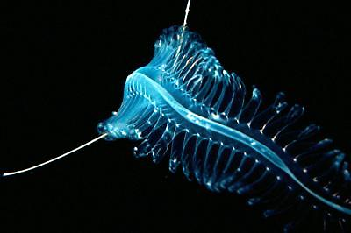

Slide 75
MEETING
DESIGN SOLUTION
ROOM FIRST CONCEPT

Slide 76
MEETING
DESIGN SOLUTION
RECESSED LINEAR DOWNLIGHTS
ROOM FIRST CONCEPT

Slide 77
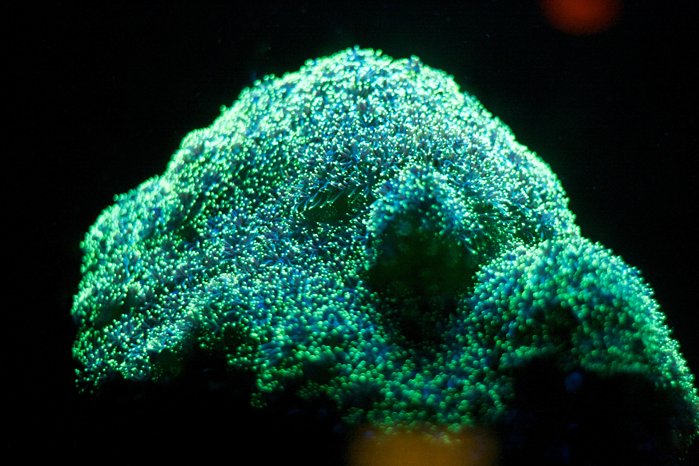

Slide 78
MEETING
DESIGN SOLUTION
ROOM SECOND CONCEPT

Slide 79
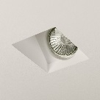
MEETING
DESIGN SOLUTION
RECESSED DOWNLIGHTS
RECESSED WALL – WASHERS
ROOM SECOND CONCEPT

Slide 80
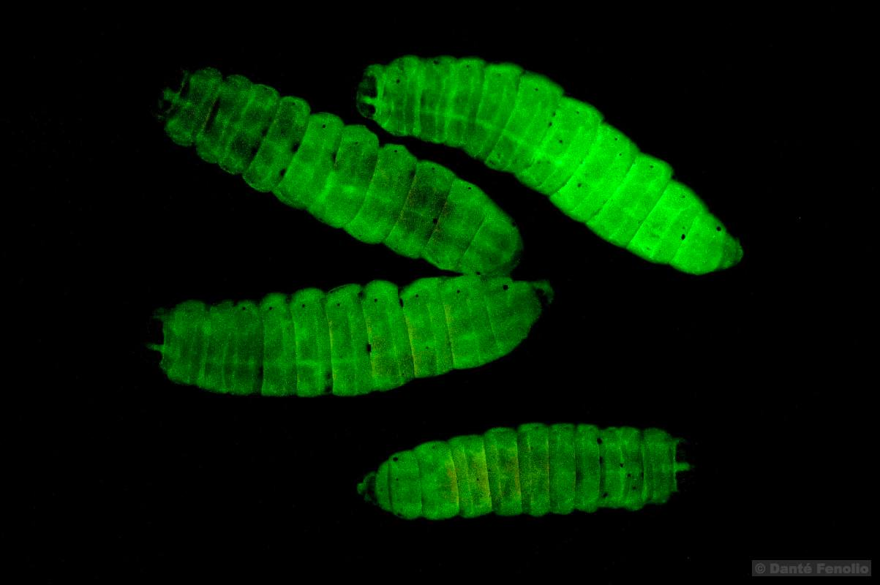

Slide 81
MEETING
DESIGN SOLUTION
ROOM THIRD CONCEPT

Slide 82
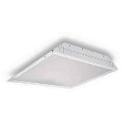
MEETING
DESIGN SOLUTION
RECESSED 4 X 4 TROFFERS
ROOM THIRD CONCEPT

Slide 83
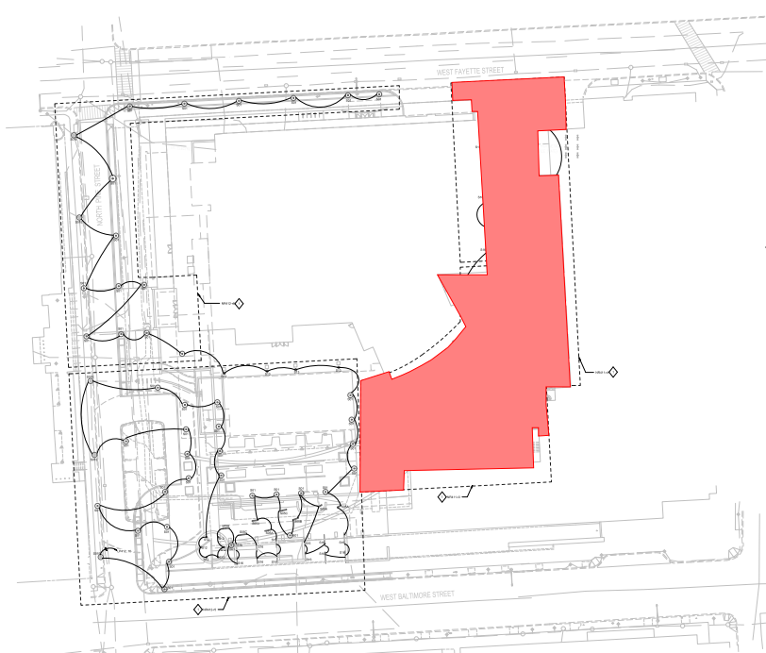

EXTERIOR
PLAZA

Slide 84
EXTERIOR
DESIGN CRITERIA
ASSUMED HIGH ACTIVITY AREAS
APPLY MODERATELY HIGH AMBIENT LIGHTING SCHEME
FACIAL RECOGNITION
N
PLAZA

Slide 85
EXTERIOR
DESIGN CRITERIA
PLAZAS AND TOWN SQUARES
HORIZANTAL ILLUMINANCE: 6 LUX
VERTICAL ILLUMINANCE: 2 LUX
RAMPS, STAIRS AND STEPS
HORIZANTAL ILLUMINANCE: 8 LUX
VERTICAL ILLUMINANCE: 4 LUX
LIGHTING POWER ALLOWANCES
WALKWAYS < 10 FT WIDE: 0.8 W/FT²
PLAZA AREAS: 0.8 W/FT²
STAIRWAYS: 0.8 W/FT²
LANDSCAPING: 0.8 W/FT²
N
PLAZA

Slide 86
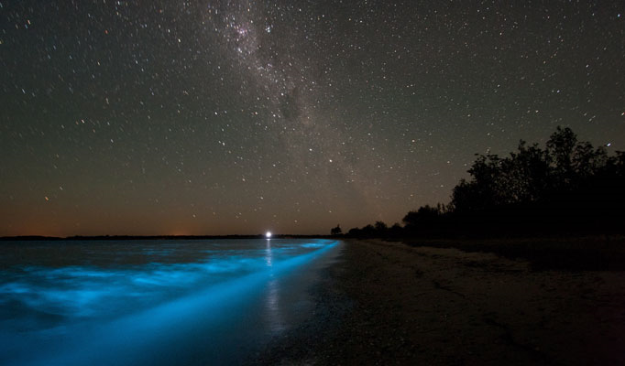

Slide 87
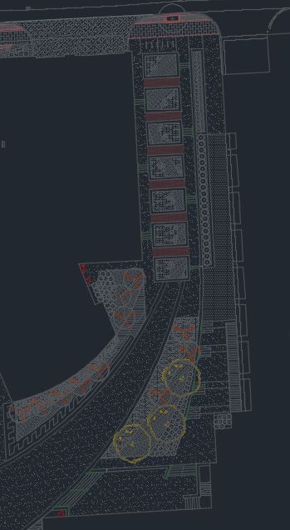
N

Slide 88
N

Slide 91
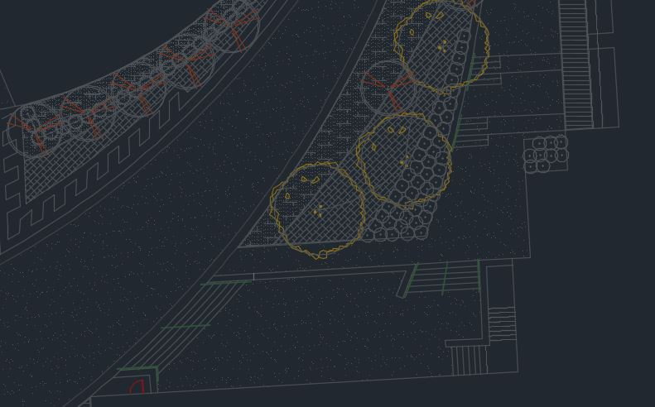
EXTERIOR
DESIGN SOLUTION
N
PLAZA

Slide 92
EXTERIOR
DESIGN SOLUTION
HANDRAIL LIGHTING
N
PLAZA

Slide 93


Slide 94
EXTERIOR
DESIGN SOLUTION
HANDRAIL LIGHTING
N
PLAZA

Slide 95

EXTERIOR
DESIGN SOLUTION
HANDRAIL LIGHTING
FLOOD LIGHTS
N
PLAZA

Slide 96

EXTERIOR
DESIGN SOLUTION
HANDRAIL LIGHTING
FLOOD LIGHTS
BOLLARDS
N
PLAZA

Slide 98

EXTERIOR
DESIGN SOLUTION
HANDRAIL LIGHTING
FLOOD LIGHTS
BOLLARDS
N
PLAZA

Slide 99

EXTERIOR
DESIGN SOLUTION
HANDRAIL LIGHTING
FLOOD LIGHTS
BOLLARDS
EXTERIOR TAPE LIGHT
N
PLAZA

Slide 101

EXTERIOR
DESIGN SOLUTION
HANDRAIL LIGHTING
FLOOD LIGHTS
BOLLARDS
EXTERIOR TAPE LIGHT
N
PLAZA

Slide 102
FINAL
HEALTH SCIENCE FACILITY III
UNIVERSITY OF BALTIMORE – MARYLAND NEWEST RESEARCH FACILITY
THOUGHTS

Slide 103
FINAL
HEALTH SCIENCE FACILITY III
UNIVERSITY OF BALTIMORE – MARYLAND NEWEST RESEARCH FACILITY
THEME OF BIOLUMINESCENCE
THOUGHTS

Slide 104
FINAL
HEALTH SCIENCE FACILITY III
UNIVERSITY OF BALTIMORE – MARYLAND NEWEST RESEARCH FACILITY
THEME OF BIOLUMINESCENCE
PSYCHOLOGICAL IMPRESSION OF SPACIOUSNESS
THOUGHTS

Slide 105


FINAL
HEALTH SCIENCE FACILITY III
UNIVERSITY OF BALTIMORE – MARYLAND NEWEST RESEARCH FACILITY
THEME OF BIOLUMINESCENCE
PSYCHOLOGICAL IMPRESSION OF SPACIOUSNESS
THREE SCHEMATIC CONCEPTS
THOUGHTS

Slide 106
REFERENCES
ASHRAE Standard 90.1 – Energy Standard for Buildings Except Low-Rise Residential Buildings. 2013 ed. N.P.: ASHRAE, n.d. Print.
DiLaura, David, Kevin Houser, Richard Mistrick, and Gary Steffy. Illuminating Engineering Society The Lighting Handbook. 10th ed. N.p.: ISENA, n.d. N. pag. Print.
Images provided by Barton Malow and HOK.

